Slide 1

Predictive Analytics for Medical Examinations
December 8, 2017
Kenda Ransom
DS700
Fargo Health Group Case Study

Slide 2
Overview
Project Description
Problem Identification
Stakeholders
Project Methodology
Data Analytics Approach
Data Collection
Data Cleaning
Data Imputation
Forecasting Models
Forecast Results
Statistical Analysis Terms
Holt-Winters & ARIMA Statistical Analysis
Ethics
Conclusion
Future Use

Slide 3
Project Description
Problem Identification
Stakeholders
Lost revenue due to Health Center’s inability to process an exam request in less than 30 days
$200 fine paid to Regional Office of Health Oversight
$1,250 to outsource exam Out-of-Network
Identified using RACI
Responsible – Kenda Ransom
Accountable – Jay Rubin (Director of QAO)
Consulted – Local Offices (LO), Health Centers (HC)
Informed – Anthony Bryant (CEO)

Slide 4
Project Methodology – Data Analytics Approach
Forecast heart exams for Abbeville HC for next 12 months
Collect dataset
Cleanse, impute, and analyze final dataset
Create 2 forecasting models
Select best model based on statistical analysis
Report forecasting model results

Slide 5
Project Methodology – Data Collection
Data Collection
Explanation of Dataset
Excel workbook from January 2006 – December 2013
Data from multiple HC’s
Multiple exam types
Not all heart related data
Multiple data formats
Exam Name
SYSID number
Multiple date formats
07 – May
12 May, 2007
Missing data
Define heart related exams
Select heart related exams originating from Abbeville
Multiple months & years in a HC’s data tab
May 2007 tab had May 2007 and May-July 2013 data
October 2008 Abbeville data is abnormally high due to New Orleans HC being closed
5,129 heart exams from December 2009 through February 2010, but HC’s not identified

Slide 6
Project Methodology – Data Cleansing
Data Issues
Duplicate exams
Missing values
Erroneous values
Punctuation
Text instead of numeric values
Date format

Slide 7
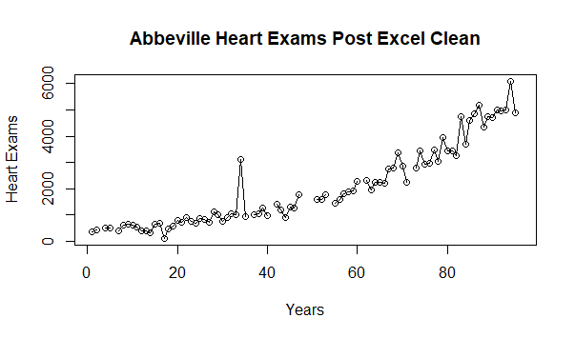
Project Methodology – Data Cleansing Cont’d

Slide 8
Project Methodology – Data Imputation
HC data from Excel was totaled and imputed in applicable rows
MICE package in R
5 linear regressions
Majority of imputed data points were median value of the 5 linear regressions
2008 imputed using random sample
December 2009-February 2010 data was imputed differently

Slide 9
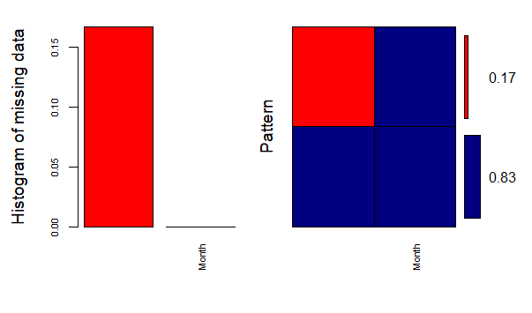
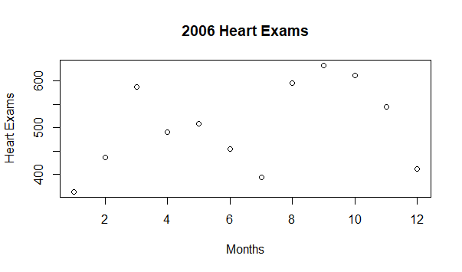
Project Methodology – Data Imputation - 2006
Missing March and June data
March – 588
June - 454

Slide 10
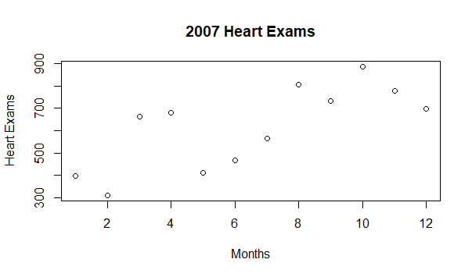
Project Methodology – Data Imputation - 2007

Slide 11

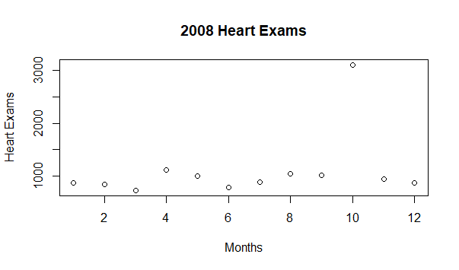
Project Methodology – Data Imputation - 2008
Missing December data
1 | 2 | 3 | 4 | 5
3110 | 886 | 875 | 724 | 840

Slide 12
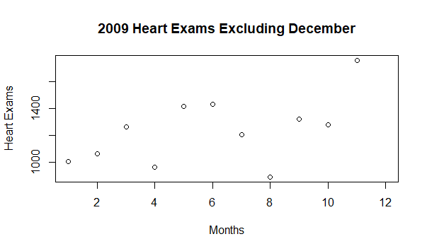
Project Methodology – Data Imputation - 2009
Missing May and December data
May – 1413
December handled separately

Slide 13
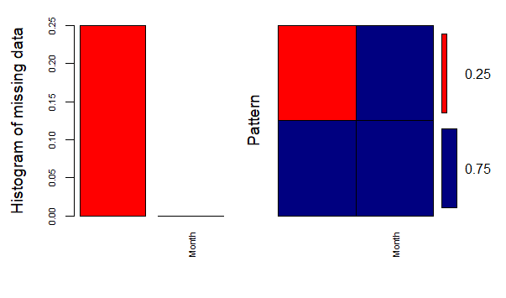
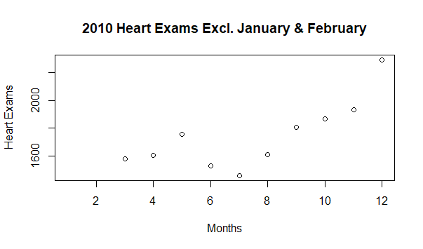
Project Methodology – Data Imputation - 2010
Missing January, February, and June data
June – 1629
January & February handled separately

Slide 14
Project Methodology – Data Imputation – December 2009 – February 2010
Missing Data
Imputation Method
5,129 heart exams requested during 12/2009-2/2010
Heart exams are not identified per HC
Not imputed using MICE
Use 2007, 2008, and eleven months of 2009 data
Calculate mean monthly percentage for of exams for December, January, and February
Calculate yearly total exams
Calculate yearly standard deviation

Slide 15
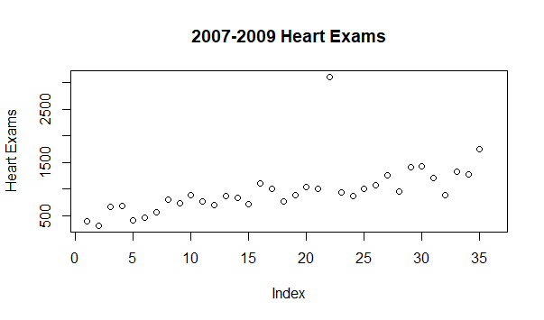
Project Methodology – Data Imputation – December 2009 – February 2010

Slide 16
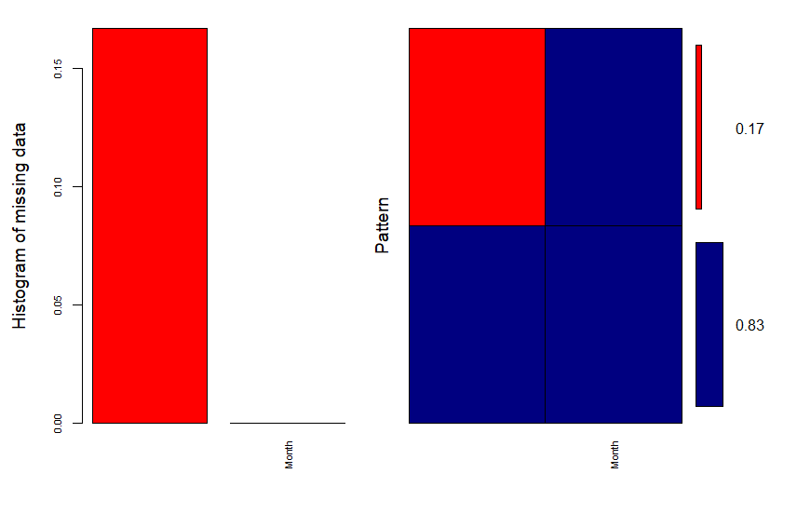
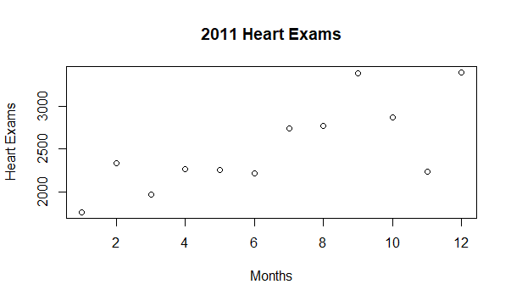
Project Methodology – Data Imputation - 2011
Missing January and December
January - 1763
December - 3393

Slide 17
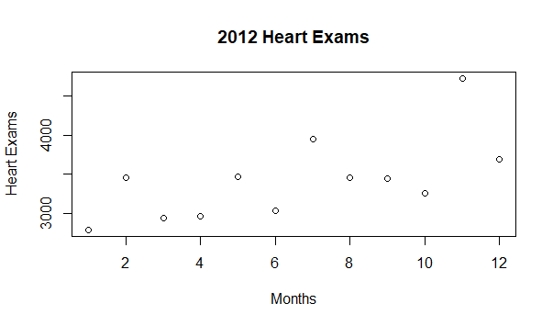
Project Methodology – Data Imputation – 2012

Slide 18
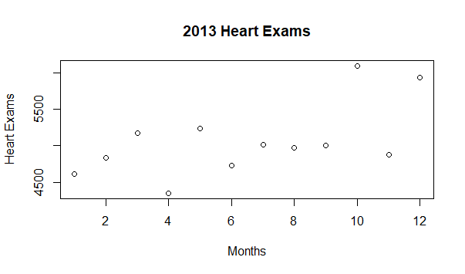
Project Methodology – Data Imputation – 2013

Slide 19
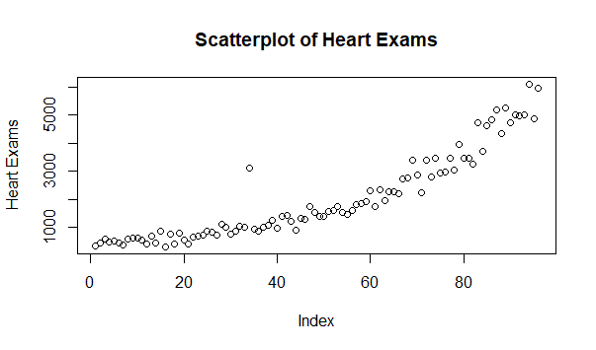
Project Methodology – Data Imputation – Cleaned & Imputed Dataset

Slide 20
Project Methodology – Forecast Models
Holt-Winters
ARIMA
Double Exponential Smoothing
Ability to handle data with increasing trend
Reliable for long term forecasting
Regression approach
Ability to handle October 2008 data spike
Auto picks the best fit
Ability to handle data with trend and seasonality
Analyzed using ACF and PACF
Auto regression
Moving average
Ability to handle October 2008 data spike

Slide 21
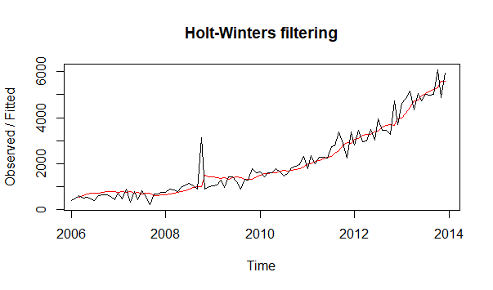
Project Methodology – Forecast Models – Holt Winters

Slide 22
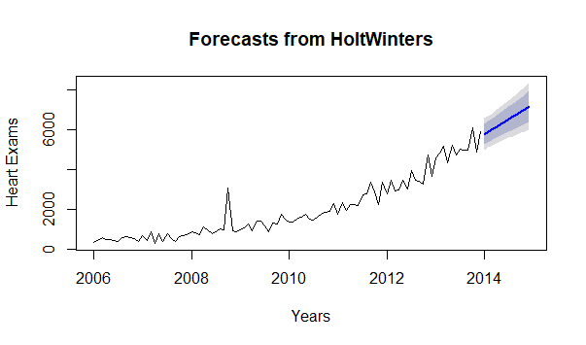
Project Methodology – Forecast Models – Holt Winters

Slide 23
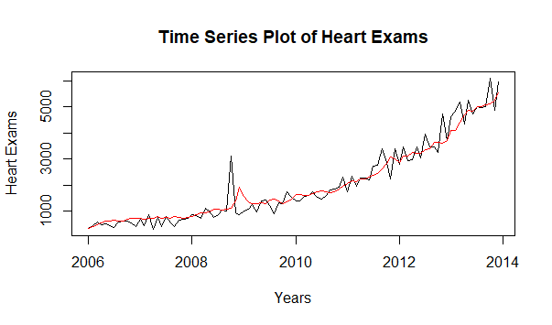
Project Methodology – Forecast Models – ARIMA

Slide 24
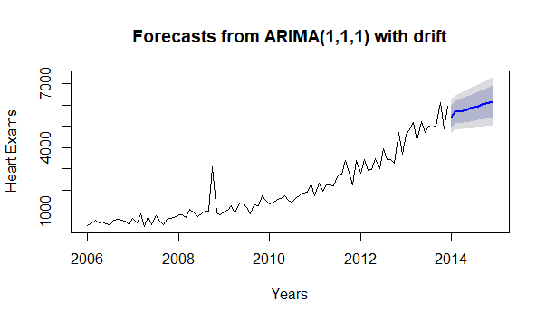
Project Methodology – Forecast Models – ARIMA

Slide 25
Forecast Results
Statistical Analysis
Mean Absolute Deviation/Error
Sum of absolute values of errors
Mean Absolute Percentage Error
Percent magnitude of error

Slide 26
Forecast Results
Holt-Winters
ARIMA
MAD | MAPE
280 | 20
MAD | MAPE
256 | 19

Slide 27
Ethics
Are patients aware of their data being used?
Security measures for data safeguarding
Distribution of results

Slide 28
Conclusion
15% increase in heart exams at Abbeville in 2014
Aid in appropriate staffing of physicians to meet the 30-day turnaround
Reduce lost revenue
Keep or increase patient satisfaction with Fargo Health Group

Slide 29
Conclusion – Future Use
Data Standardization
Future Analysis
Explicit compliance to HIPAA
Exam naming convention
Relation of condition to exam type
Date format
Data input timeframe
Predict other types of exams at different HC’s
Predict patient visits
Requested exams related other health issues

